Slide 1
Big Mountain Resort’s New Price
By Noah Galdona

Slide 2
The Problems
The new chair lift adds $1,540,000 in operating costs this season
Finding which facilities are more valued and which ones can be cut back on to reduce operating costs

Slide 3
The Recommendations
Changes Now
Raising the ticket price to $85 dollars
This covers the new lift’s costs while preserving the number of annual visitors
Closing down 5 of the least used runs
This cuts down on operating costs greatly, without affecting ticket price expectation significantly
Future Changes
Adding a new run with a vertical drop of 150 feet and another chair lift
Increases the support for an increased ticket price

Slide 4
Modeling Results
Random Forest Model:
Mean Absolute Error (MAE) = 10.393
Standard Deviation (STD) = 1.471
These results show that the random forest model had the most accurate predictions of the models tested.
The key features highlighted:
Fast Quads lifts
Total Runs
Snow Making per Acre
Vertical drop

Slide 5
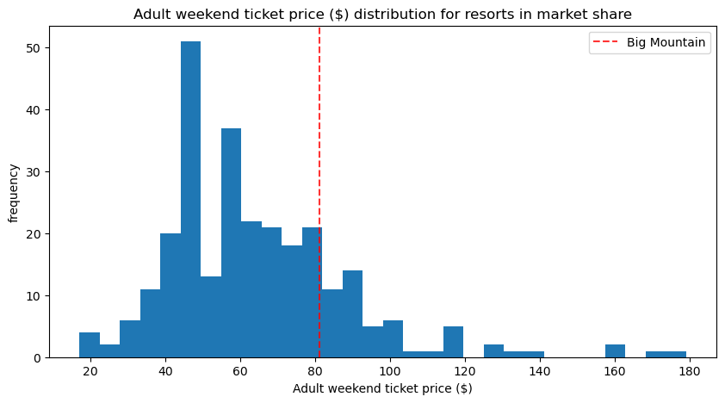
Model’s Suggested Price
Current Ticket Price isn’t even that high compared to others:
$95.87
Compared to the current ticket price of $81, even with a MAE of $10.39, shows Big Mountain is undercharging by at least $4.

Slide 6
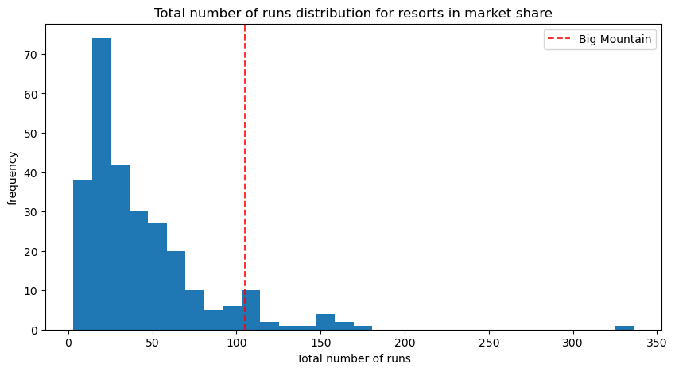
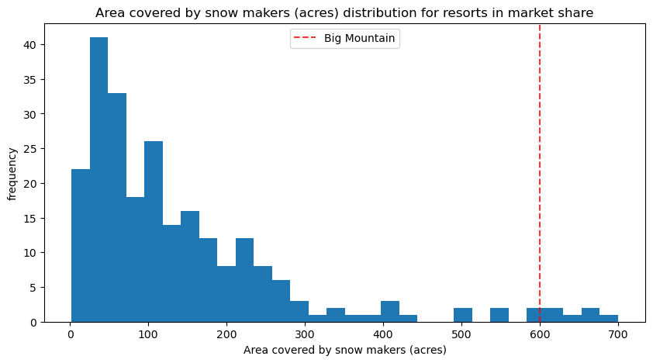
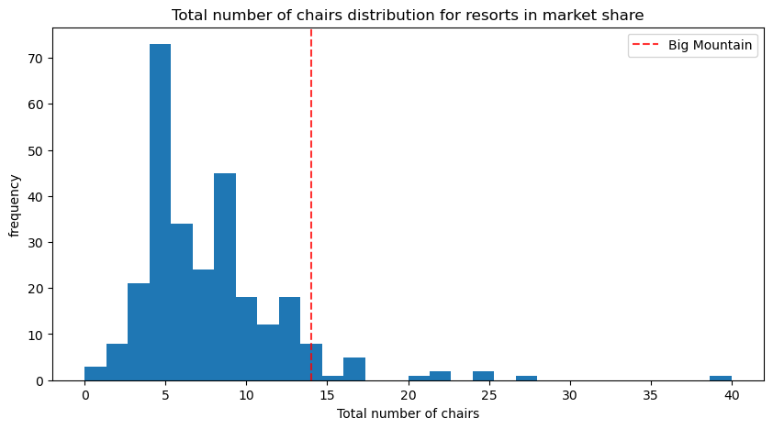
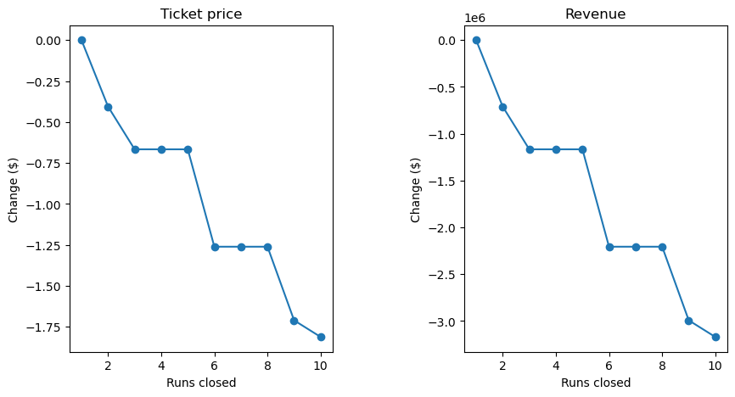
Big Mountain compared to other Ski Resorts

Slide 7
The Conclusion
As shown in the previous graphs, Big Mountain ranks at the highest in terms of the most influential features of ticket price, compared to other ski resorts in the same market, despite not being the most expensive.
This means that a higher ticket price is certainly justified. Based on calculations using 350,000 annual visitors buying on average 5-day ticket passes, a ticket price of $85 dollars will more than cover the additional operating costs, while still keeping the same number of annual visitors.
The closing down of the 5 least used runs and the affected ticket prices can be shown in the last graph, explaining how closing down 5 runs has the biggest impact in reducing operating costs while also maintaining our ticket price value as best as possible.

